Slide 1
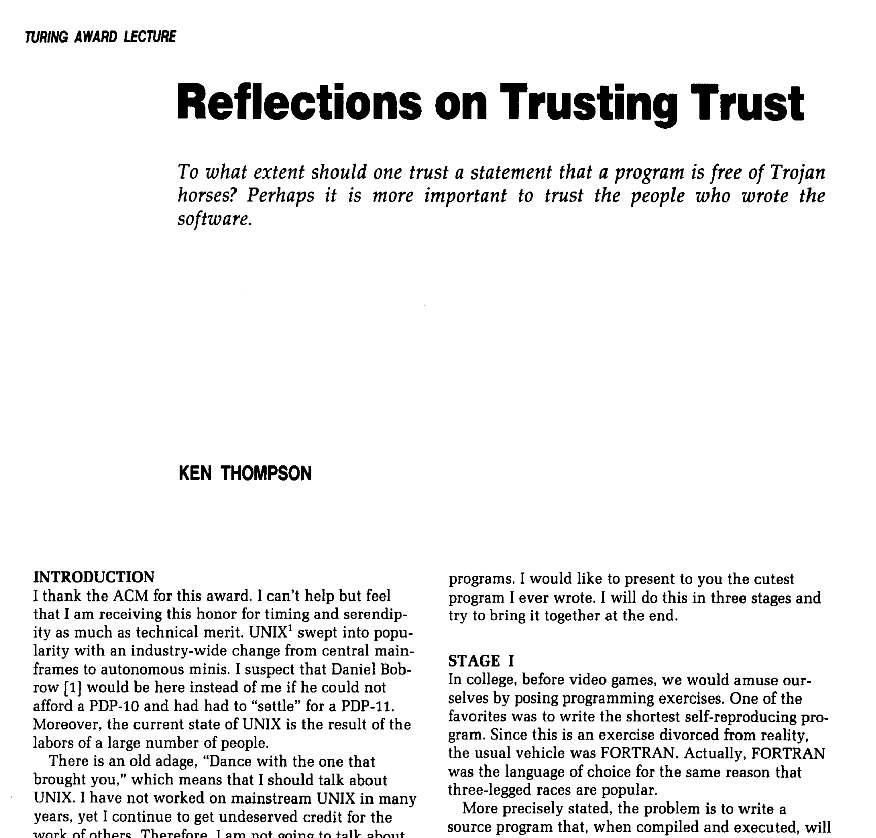

Slide 2
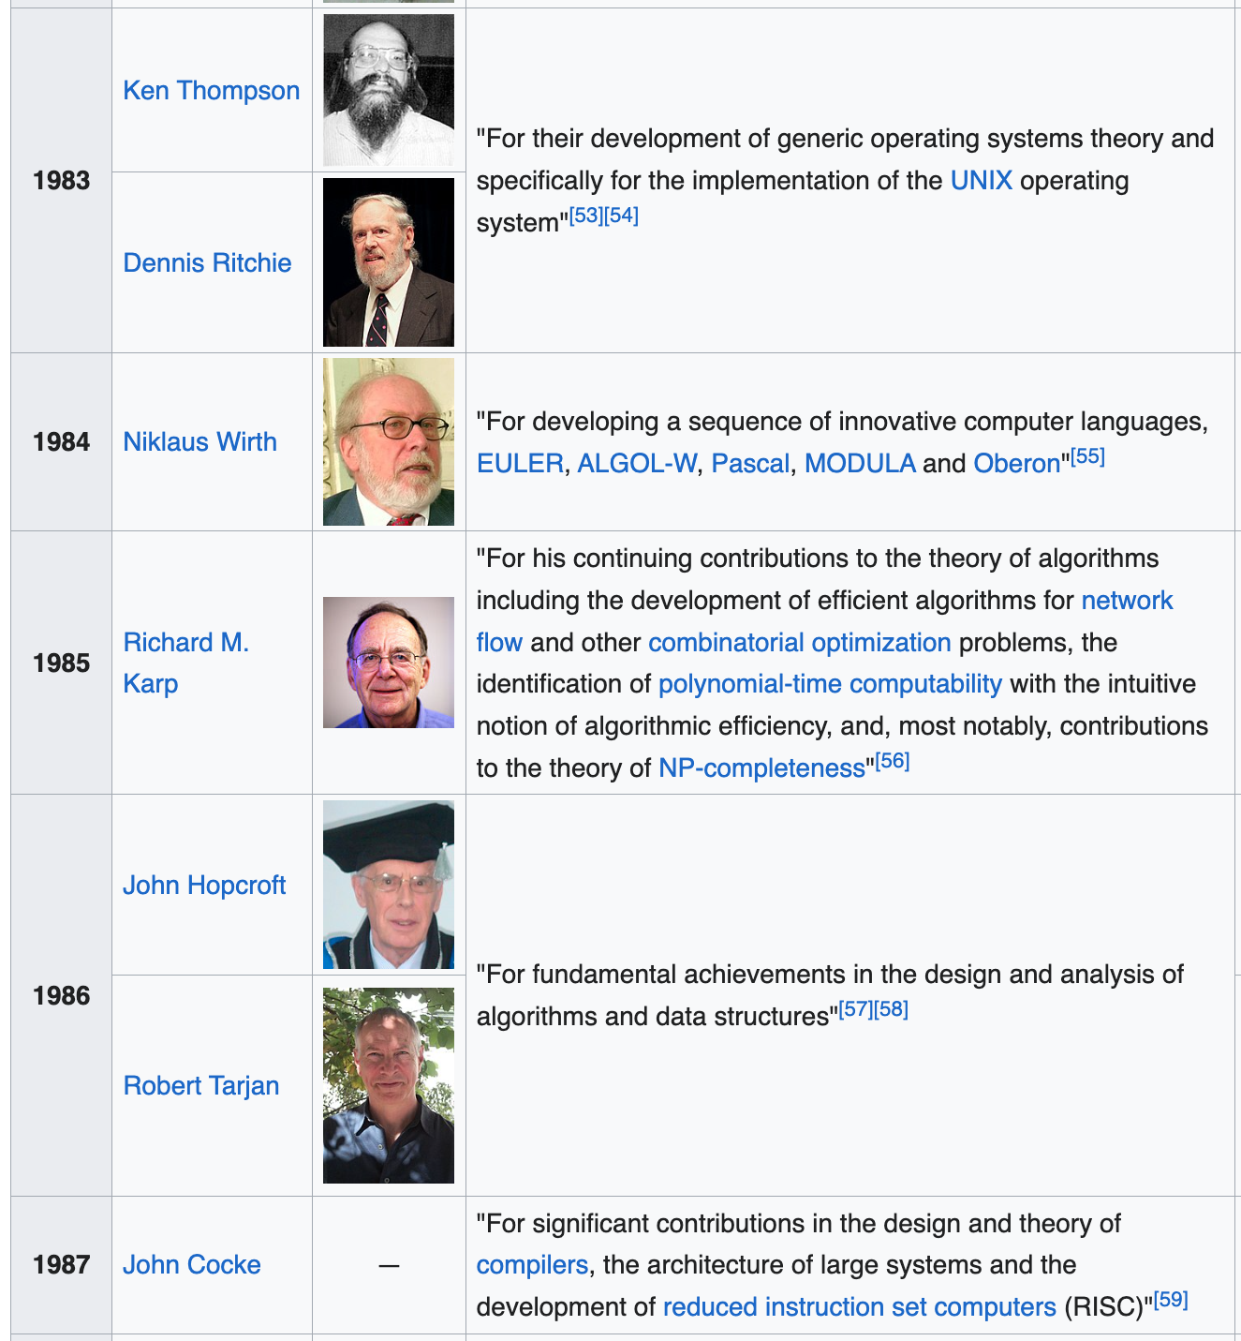
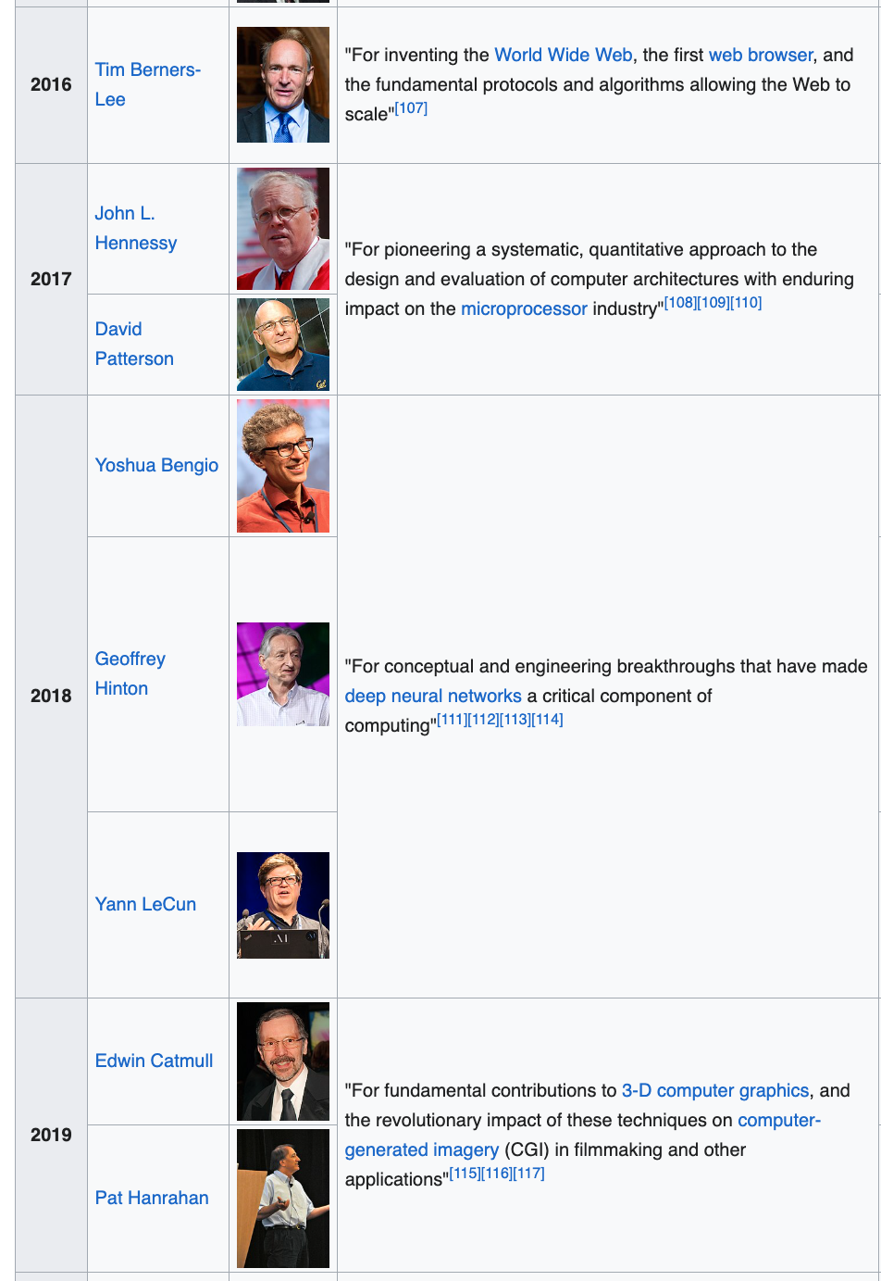
https://en.wikipedia.org/wiki/Turing_Award

Slide 3
Take-Away Message: Attack Surface has to be small enough to audit
Ken’s Example
MORAL
Figure 3.2 shows a simple modification to the compiler
that will deliberately miscompile source
whenever a particular pattern is matched.
If this were not deliberate,
it would be called a compiler "bug."
Since it is deliberate,
it should be called a "Trojan horse."
You can't trust code that you did not totally create yourself.
(Especially code from companies that employ people like me.)
No amount of source-level verification or scrutiny
will protect you from
using untrusted code

Slide 4
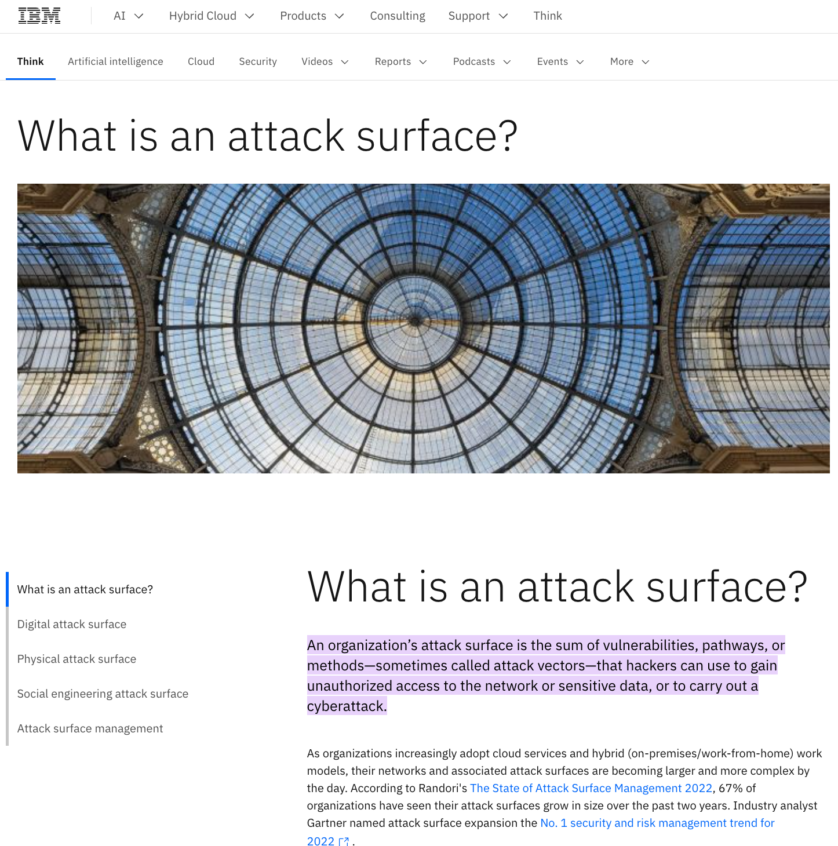
Purpose of this talk
Reading Group
Summarize main point of paper
As well as implications for contemporary audience
Current Reality:
Attack surface on phones is too large to audit
(and it will become larger in future)

Slide 5
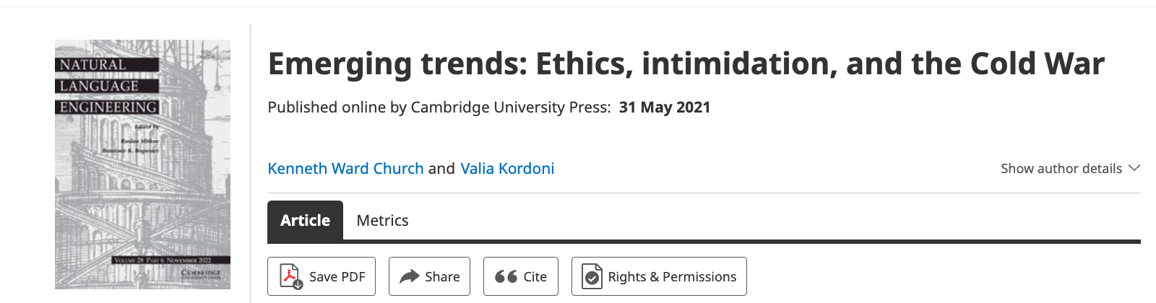
State of the Art in 1983
Security was less of a topic in 1983 than these days
When I was a grad student at MIT in 1970s
Computers in the MIT AI Lab had no security, by design.
Anyone could watch anyone do anything.
This was considered a feature, not a bug.
We were proud of the small town atmosphere.
Everyone knew everything about everyone.
When we were forced to add passwords,
Stallman (GNU) inserted a ``bug’’
that he just had to show me one night
His bug printed passwords on system terminal (hardcopy)
So everyone could see everyone’s passwords

Slide 6
Spying on Rivest (R in RSA)
While the field was still small,
Lack of security → interesting consequences for cryptography
A few years after RSA,
we crowded around a computer screen,
spying on Rivest as he was working on a subsequent paper,
suggesting that NSA had designed key lengths
for a proposed standard to be just short enough
so they could break the code and no one else could.

Slide 7
A Conspiracy Theory
Some of the others in the crowd probably
knew more about the key length controversy than we did.
Normally, these people did not spy on others,
but they encouraged us to spy on Rivest at just the right time.
They may have been working with Rivest
to leak the story with plausible deniability.

Slide 8
Flame Wars (circa late 1970s)
While no one knows
whether Rivest actually took advantage of
the lack of security to leak the story,
there is no doubt that others have used
the lack of security in creative ways.
For example, Minsky knew that a friend of his,
the head of the MIT AI lab,
was the only one in the lab
that did not read email sent to the head of the lab.
Minsky used this feature to send a flame to his friend,
knowing that his friend would not see the flame,
but others would (and did).

Slide 9
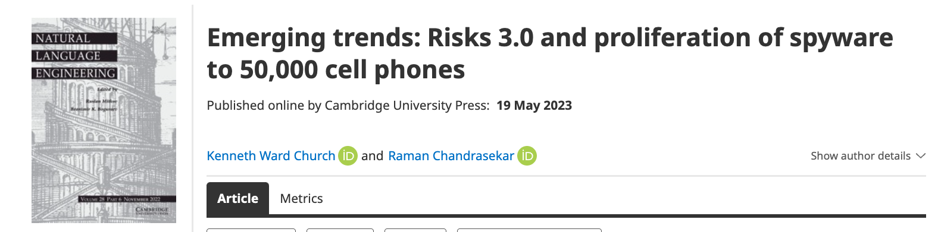
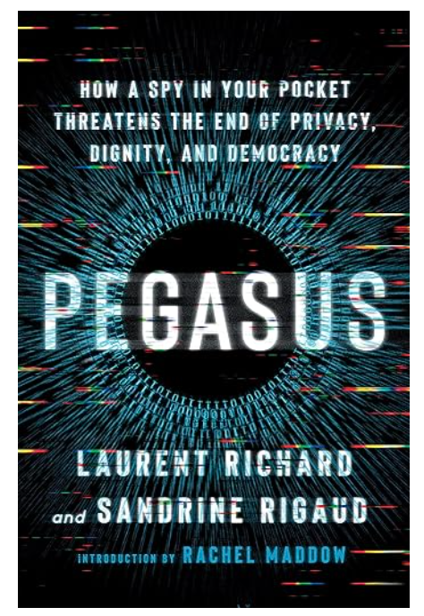
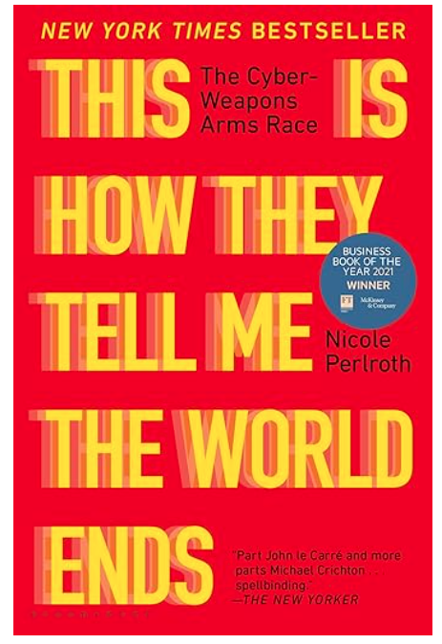
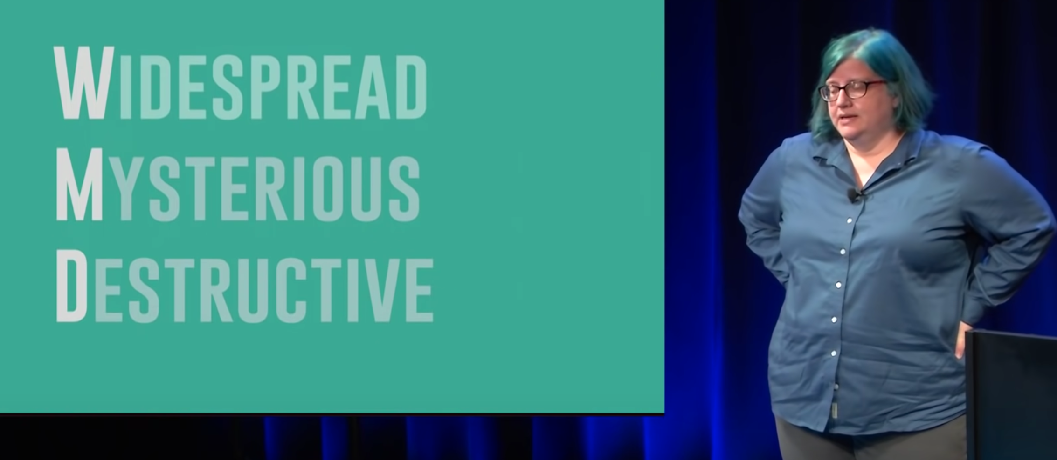
Security Today
Zero click exploits
Cheaper than divorce lawyer
Weapon of Math Destruction
Nobody but US → Bug Market

Slide 10
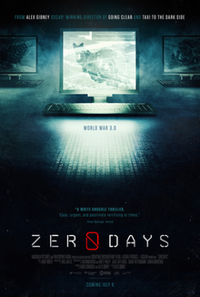
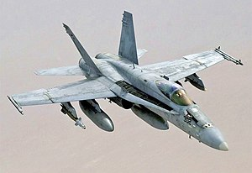
https://en.wikipedia.org/wiki/Zero_Days
Stuxnet
NOBUS: Nobody but us
https://en.wikipedia.org/wiki/NOBUS
There was a time
when cyber warfare favored us
But now that bugs are cheap
and attack surfaces are big (and growing)
Cyber favors small countries
Terrorists, mobsters, anyone with a beef
Cheaper than a fighter jet
Cheaper than a divorce lawyer
Big countries have more targets

